Slide 1
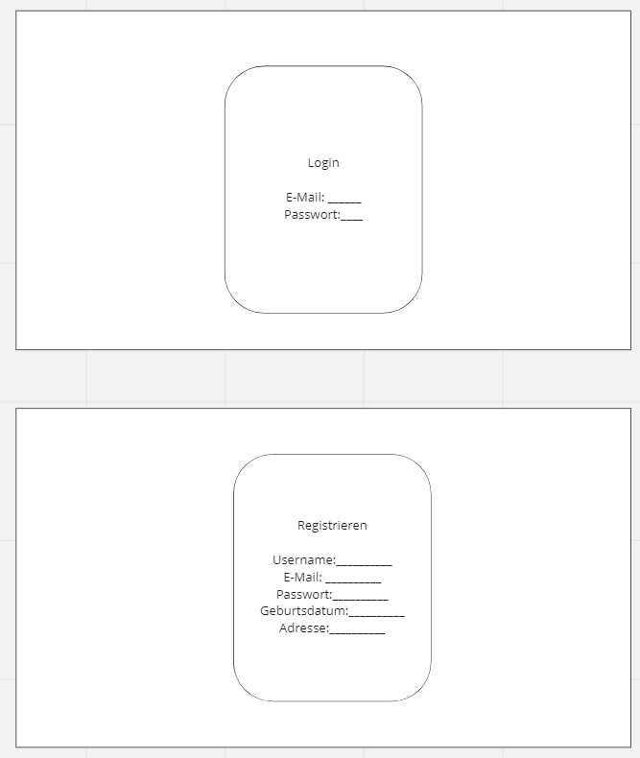
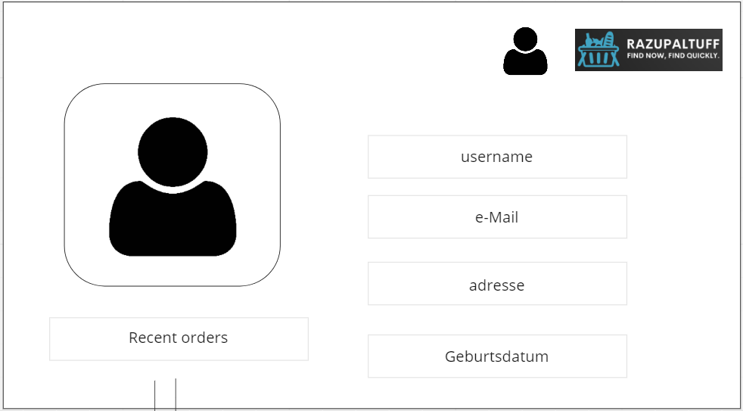
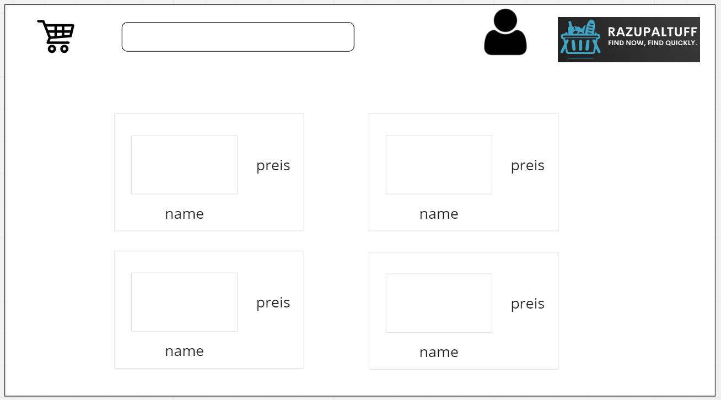
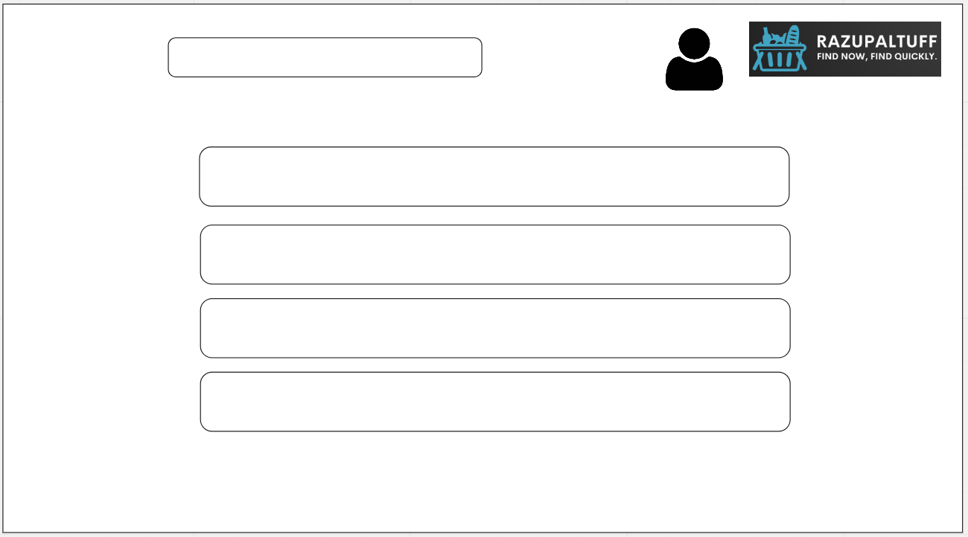
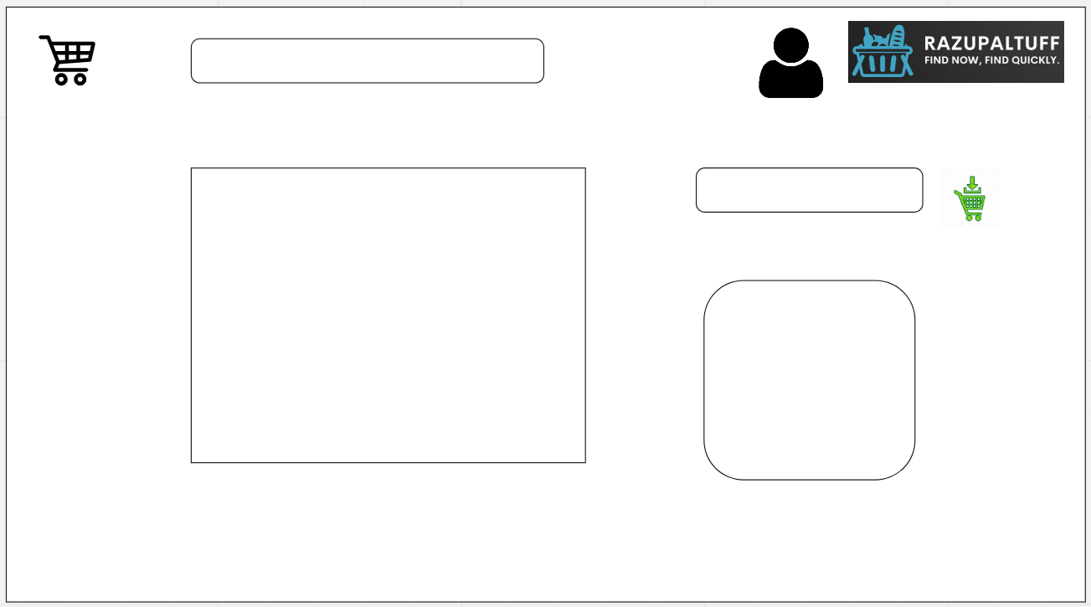
5 Usecases

Slide 2
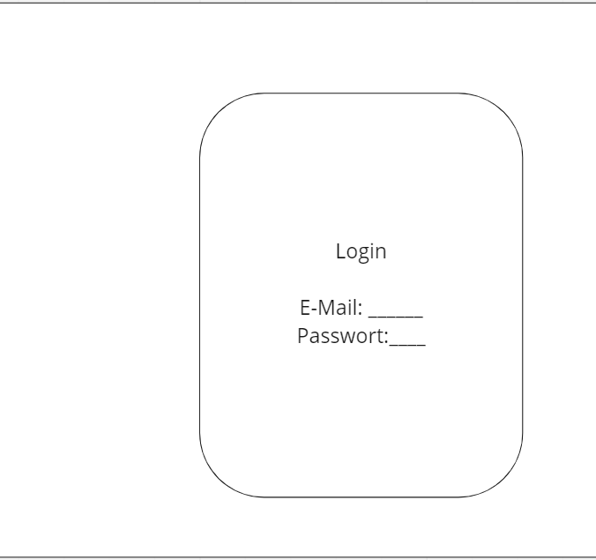
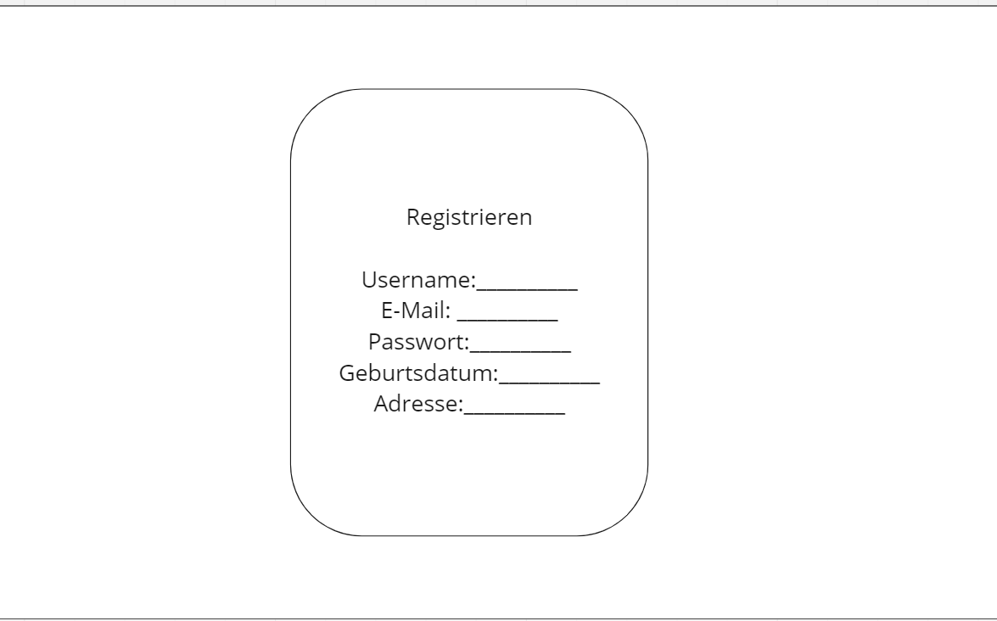
Login
Registration

Slide 3
5 Usecases

Slide 4
User Profil

Slide 5
5 Usecases

Slide 6
Home Page

Slide 7
5 Usecases

Slide 8
Warenkorb

Slide 9
5 Usecases

Slide 10
Produkt

Slide 11
5 Usecases

